Slide 1

Evaluating ‘Ways to Wellness’
Link Worker Shared Learning Event
Centre for Ageing and Vitality, Newcastle University
January 21, 2019
This work is funded by the NIHR, Public Health Research Programme, Community Groups and Health Promotion, grant no. 16/122/33. The views expressed are those of the author(s) and not necessarily those of the NHS, the NIHR or the Department of Health and Social Care.

Slide 2
Attempting to get research funded ….
2015 National Institute for Health Research
2015/16 Cabinet Office
2016 School for Public Health Research
2016 School for Primary Care Research
2017 School for Public Health Research (shortfall funding)
2017 Newcastle University Institute for Ageing
2017 National Institute for Health Research, Public Health Research Programme: 16/122 Community groups and health promotion
Unsuccessful
Successful
Unsuccessful
Unsuccessful
Successful
Successful
Successful

Slide 3
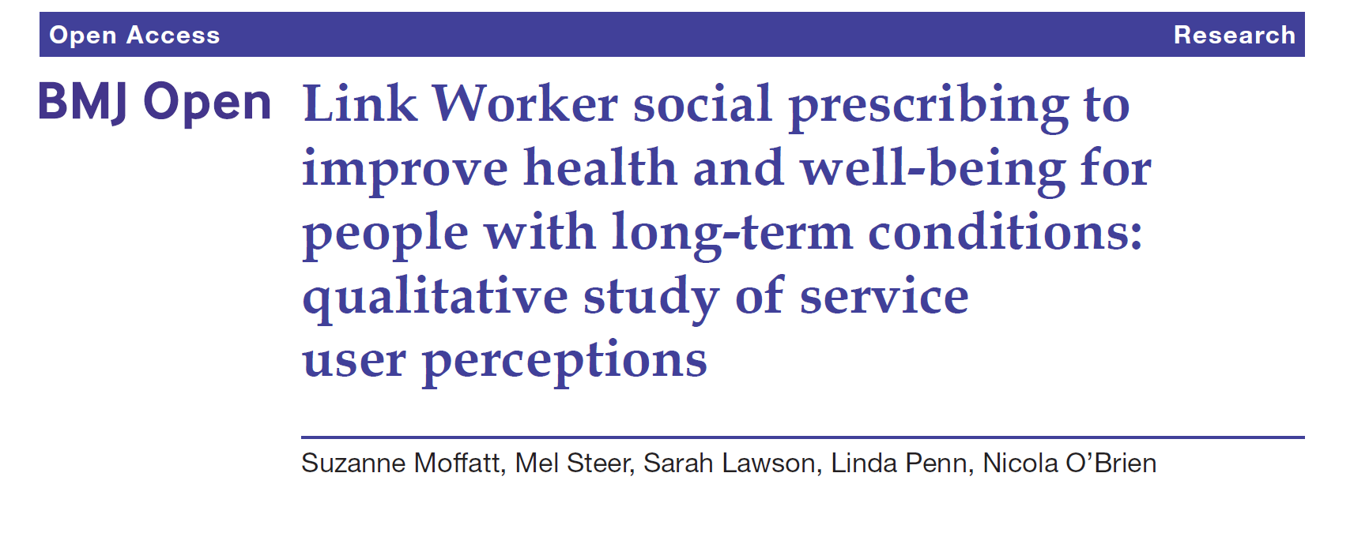
BMJ Open 2017; 7:e015203

Slide 4
“I am on the road [to better health] but it is slow … if it was easy I would have
done it years ago … I have been well impressed [with Ways to Wellness] …
because they have a very practical approach and know it has got to be
incremental … you can’t do everything at once … you can’t do everything at once so you have got to start small and build up … they have got the big picture in
mind.” (woman aged 55-59 years)
“Whatever money I owed like electricity and TV licence was in my mind always
eating me from inside. [Link worker] sorted that out and it just changed so many things …. It changed my attitude, it changed my behaviour and it changed my mood …. I am not depressed like before … I feel better about everything … I go
out almost every day … I write, I do jobs at home … yes, a big change.”
(woman 45-49 years)

Slide 5



Public Health Research Programme: 16/122 Community groups and health promotion
Project title
Impact of a community based social prescribing intervention on people
with type 2 diabetes in an ethnically diverse area of high socio-economic
deprivation. Exploiting a natural experiment to evaluate effects on health
and health care utilisation with economic assessment and ethnographic
observation.
Aims to evaluate the impact and costs of a community-based
link worker social prescribing intervention on the health and
health care utilisation of adults aged 40-74 with type 2 diabetes,
living in a multi-ethnic area of high socio-economic deprivation.

Slide 6
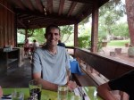
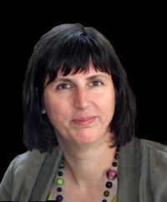
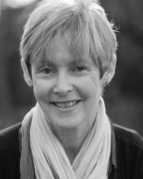
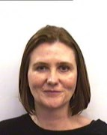
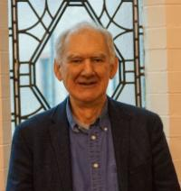
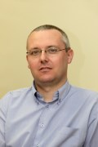
Research Team
Suzanne Moffatt John Wildman Tessa Pollard
Chris Drinkwater Mark Pearce Jo Wildman

Slide 7
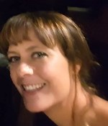
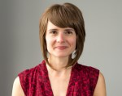
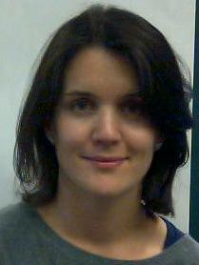
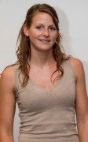
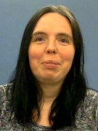
Research Team
Kate Gibson Jayne Jefferies Bethan Griffiths
Nicki O’Brien Linda Penn Allison Lawson

Slide 8
Statistical data – routinely collected
Quality and Outcomes Framework (QOF) data
The QOF is a GP performance management and payment system.
It rewards GP practices in England for the quality of care they provide to their patients.
E.g. QOF indicator: % of patients with diabetes and history of CVD who are prescribed a statin
Data on type 2 diabetes management, smoking, weight, blood pressure etc.

Slide 9
Statistical data – routinely collected
Secondary Uses Service (SUS) data
Used for healthcare planning, hospital payments and commissioning etc.
Information collected whenever a patient or service user is treated or cared for
E.g. hospital visit, admission (routine or emergency), length of stay etc.

Slide 10
Treatment and control groups
Group 1
Treatment: Eligible patients in WtW referring GP practices who have been with WtW for a year or more
Control: patients who have just started with WtW
Group 2
Treatment: Patients in WtW
Control: eligible patients in WtW referring practices who are NOT in the WtW service.
Group 3
Treatment: Patients in WtW
Control: Eligible patients NOT in WtW referring practices
Group 4
Treatment: All eligible patients in WtW referring practices (regardless of whether they take part)
Control: Eligible patients NOT in WtW referring practices

Slide 11
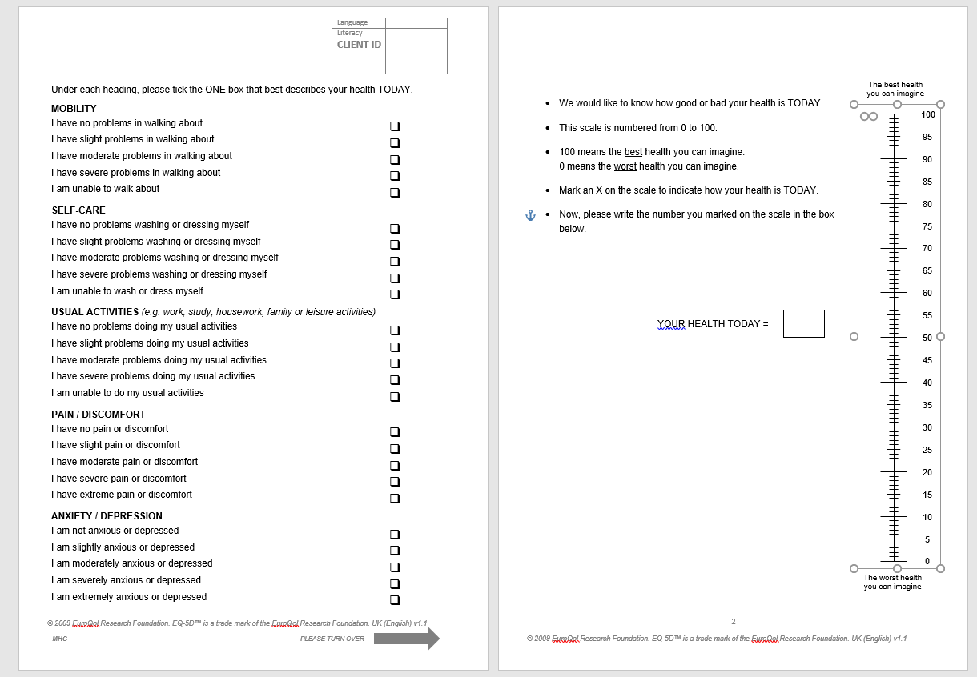
EQ-5D-5L
Measures health-related quality of life
Nearly 30 years’ old
Used for outcome measurement and economic evaluation
Two parts:
Descriptive system: health states
11111 best to 55555 worst health state
Visual analogue scale (best and worse states you can imagine)

Slide 12
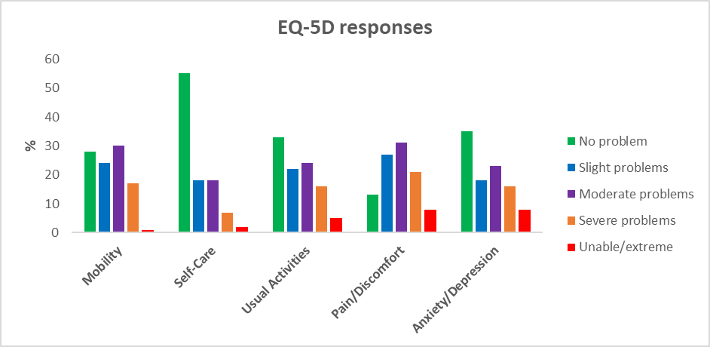
EQ-5D

Slide 13
The Ethnography
Why an ethnography?
What it involves?
Fieldwork so far

Slide 14
“it’s (WtW) the best thing that ever happened to me… they (the link worker) were listening and they were making an effort to find something for me when I was unable to do it for myself”
“The community needs this (WtW). Not wants it, needs it.”

Slide 15
Referral from primary care
WtW
VTSOs
Primary care staff
Link Workers
Volunteers and community sector staff

Slide 16
Referral from primary care
WtW
VTSOs
Primary care staff
Observing consultations to see referral process in action
Interviewing patients who both accept and decline referral
Interviewing staff about their experiences of social prescribing

Slide 17
After the patient had left Dr X explained that she was not eligible for WtW but her husband had been referred. “It’s often the way,” he added “one member of the family may be eligible and so they get in but they sort everyone out.”
After saying he couldn’t afford to retire with just state pension PN L asked “what about other benefits? Shall I get someone to come to talk to you?” [meaning WtW]. “Nah, I’ll just leave it as I am” he said.
PN said she asked people if they needed help, if they were socially isolated or needed help with forms. Dr A joked that if you say “do you want to lose weight or exercise?” the answer will always be no but if you say we have this fantastic service; we can change your [tablets] but these people can talk to you about all the other things that are important to you. Dr K agreed enthusiasm was important but that you needed feedback to know it was working

Slide 18
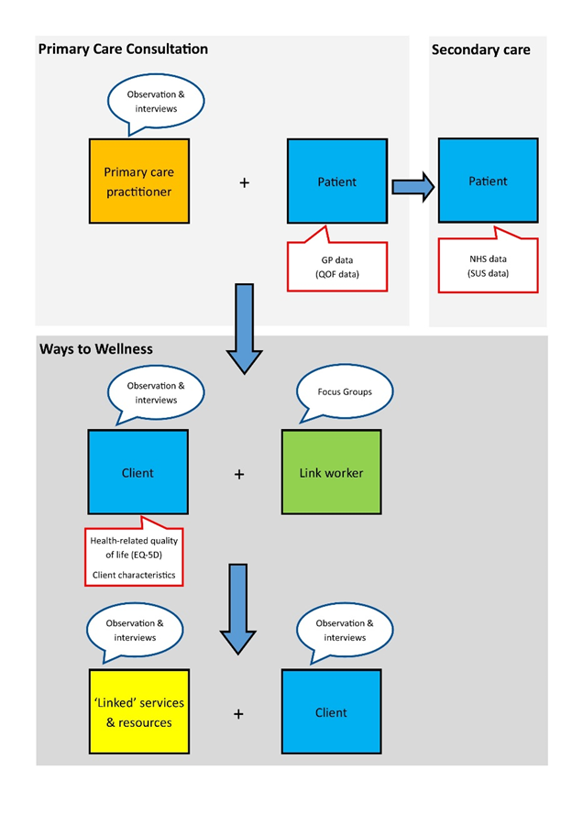
Overview of WtW evaluation – July 2018-spring 2021
https://research.ncl.ac.uk/nuspe/

Slide 19
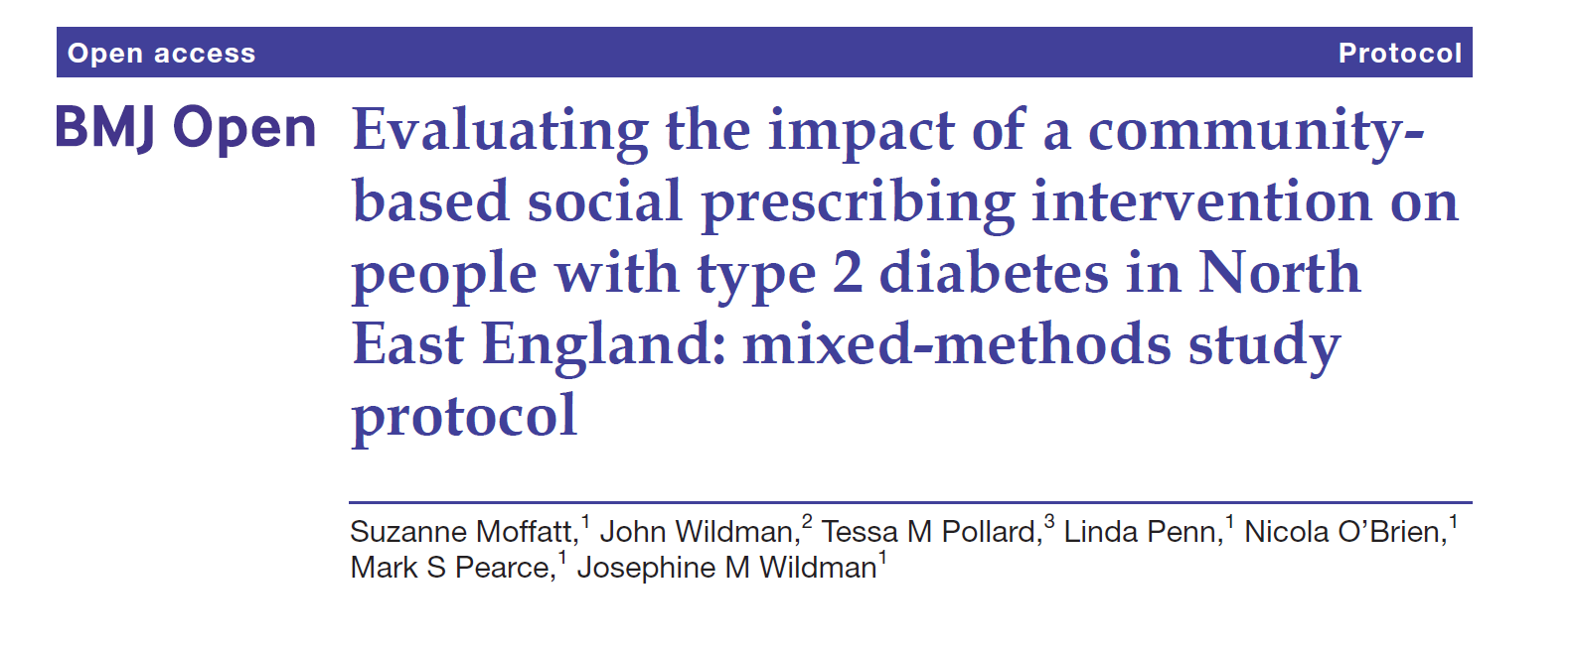

Slide 20
Thank you for listening – any questions?
Suzanne Moffatt Suzanne.moffatt@ncl.ac.uk
Jo Wildman Josephine.Wildman@ncl.ac.uk
Kate Gibson kate.gibson2@ncl.ac.uk
Tessa Pollard t.m.pollard@durham.ac.uk
Bethan Griffith b.s.griffith2@ncl.ac.uk
Allison Lawson Allison.Lawson@ncl.ac.uk

